Slide 1
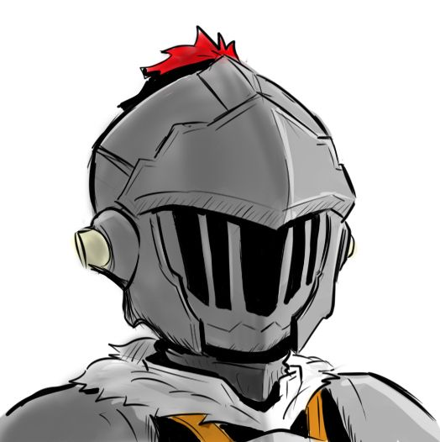






Logout
Roll initiative
Sir Marco Darius
Conan rolled a nat 1
GM:
Conan: Oh god
TPK King
G0bl1n Slayer rolled 12
Sir Marco Darius rolled 14
Players:
Karbodrid Minetank rolled 21
G0bl1n Slayer
Sir Marco Darius: Welp, Conan isn’t gonna be any help
Conan
Faylen Arra rolled 14
The orcs did not notice your arrival, you get a surprise round
HP:
14/21
Faylen Arra
It is Karbodrid Minetank’s turn
13
Karbodrid Minetank
AC:
Karbodrid Minetank: I shoot the tall orc with my longbow
Roll your to-hit with advantage
Str
-1
8
Karbodrid Minetank rolled 11 and 14
Dex
+1
12
You hit, what is your damage
Con
+2
15
Karbodrid Minetank rolled 6
Int
0
10
Alright, it is Sir Marco Darius’s turn
Wis
+2
14
Sir Marco Darius: Can I grapple the tall orc?
Cha
0
11
Sure, you will have to make an Athletics check
Sir Marco Darius: yeah I got a -1 athletics, what do you guys thing I should do
Roll
•••
Type here

